Slide 1


Attention Restoration Theory - how does time influence the outcome?

Slide 2
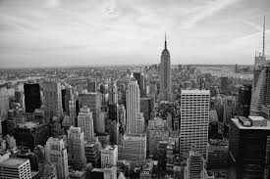

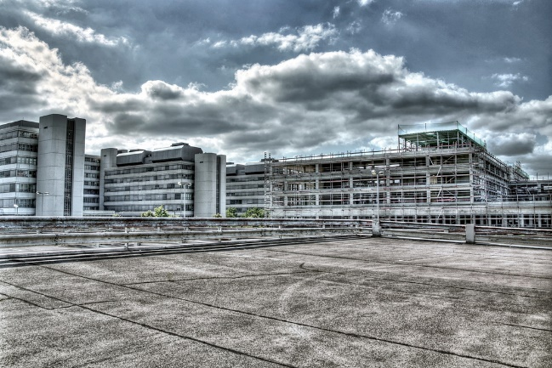
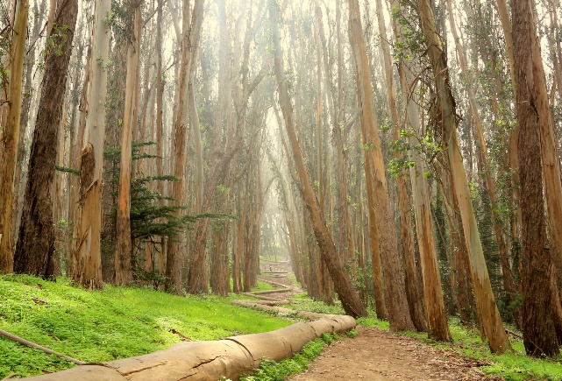
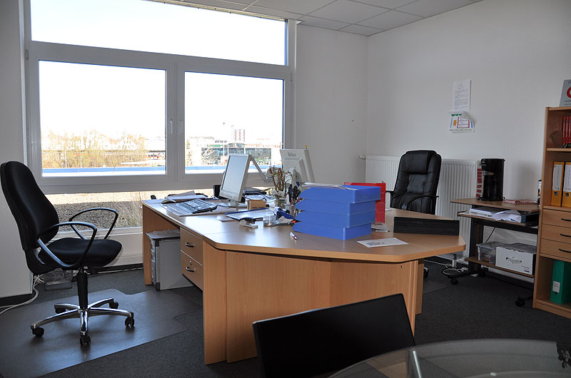
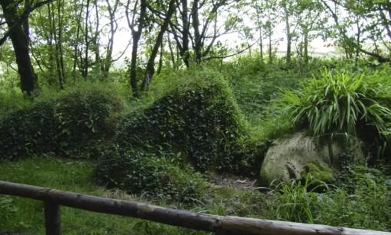
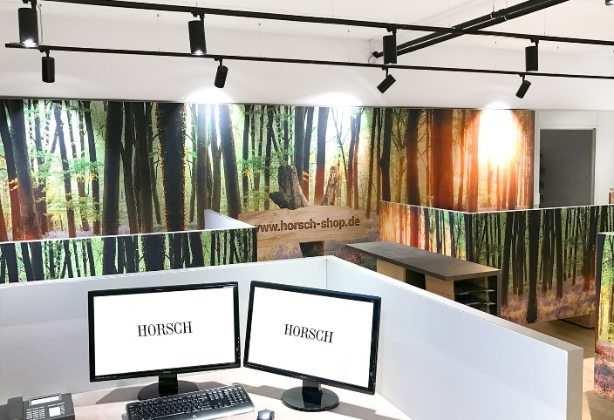
Back to Nature
Final Project Presentation
Research Practicum
IDS6916
Andres Hanchi
Markus Loennig
Marc Mailloux

Slide 3
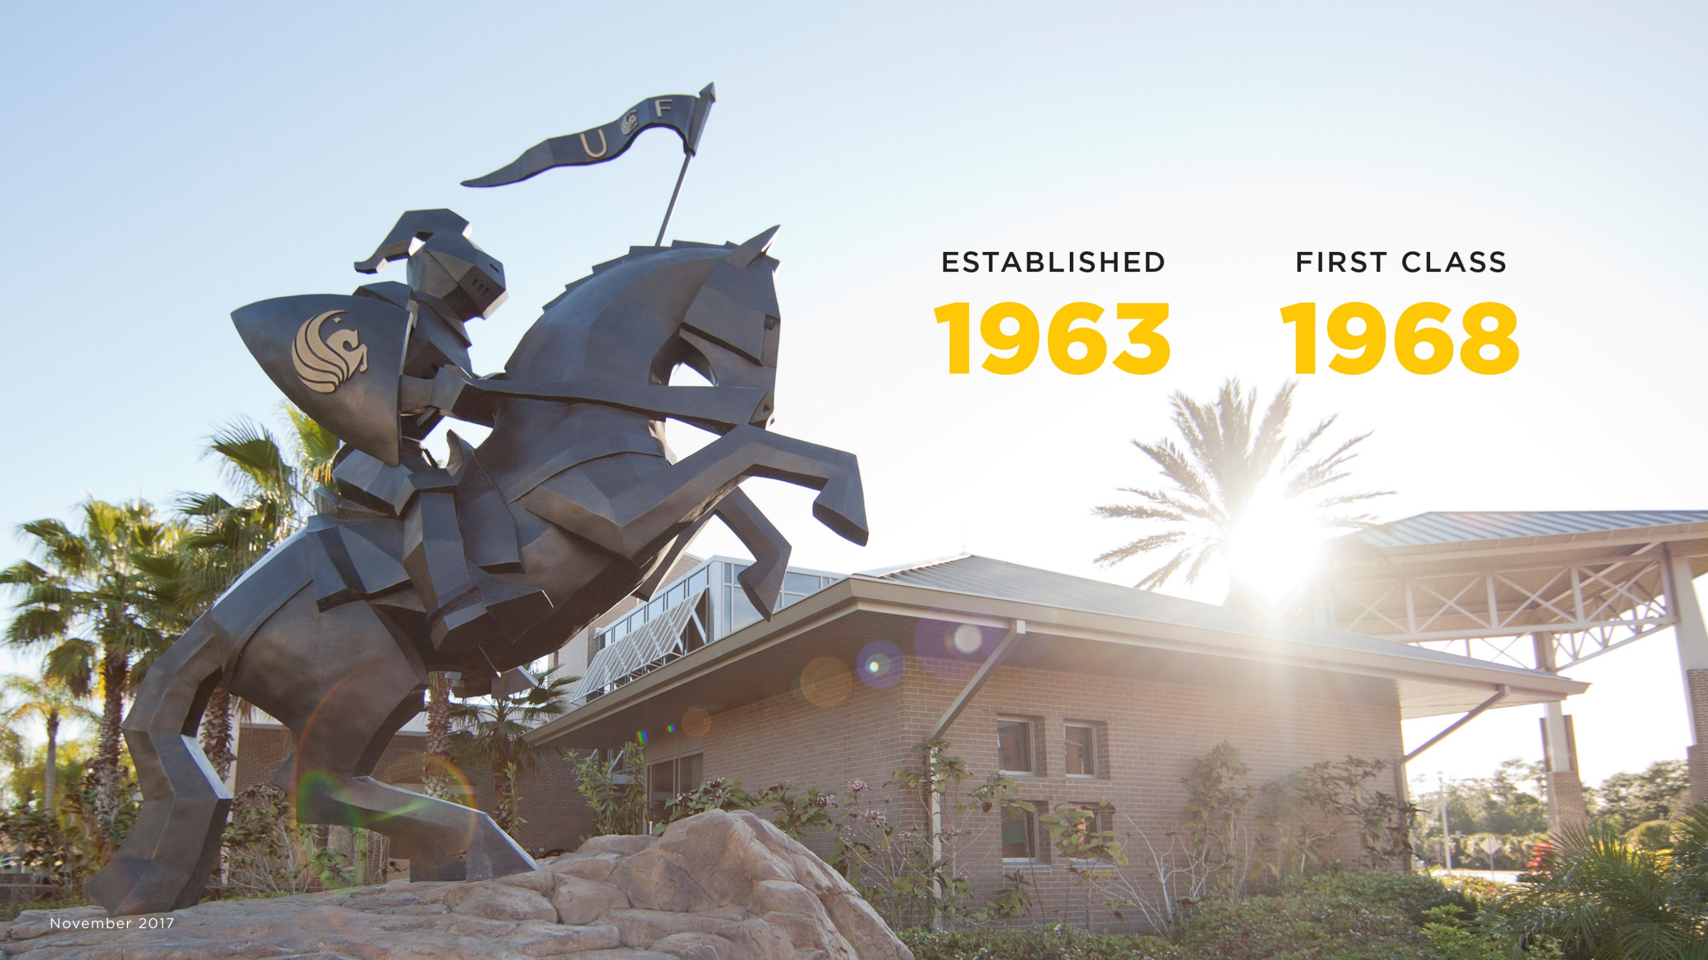
Content:
- Topic / Purpose Statement
- Introduction
- Literature Review / Related Works
- Research Question
- Research Methods
- Hypothesis
- Methods
- Results
- Conclusion

Slide 4
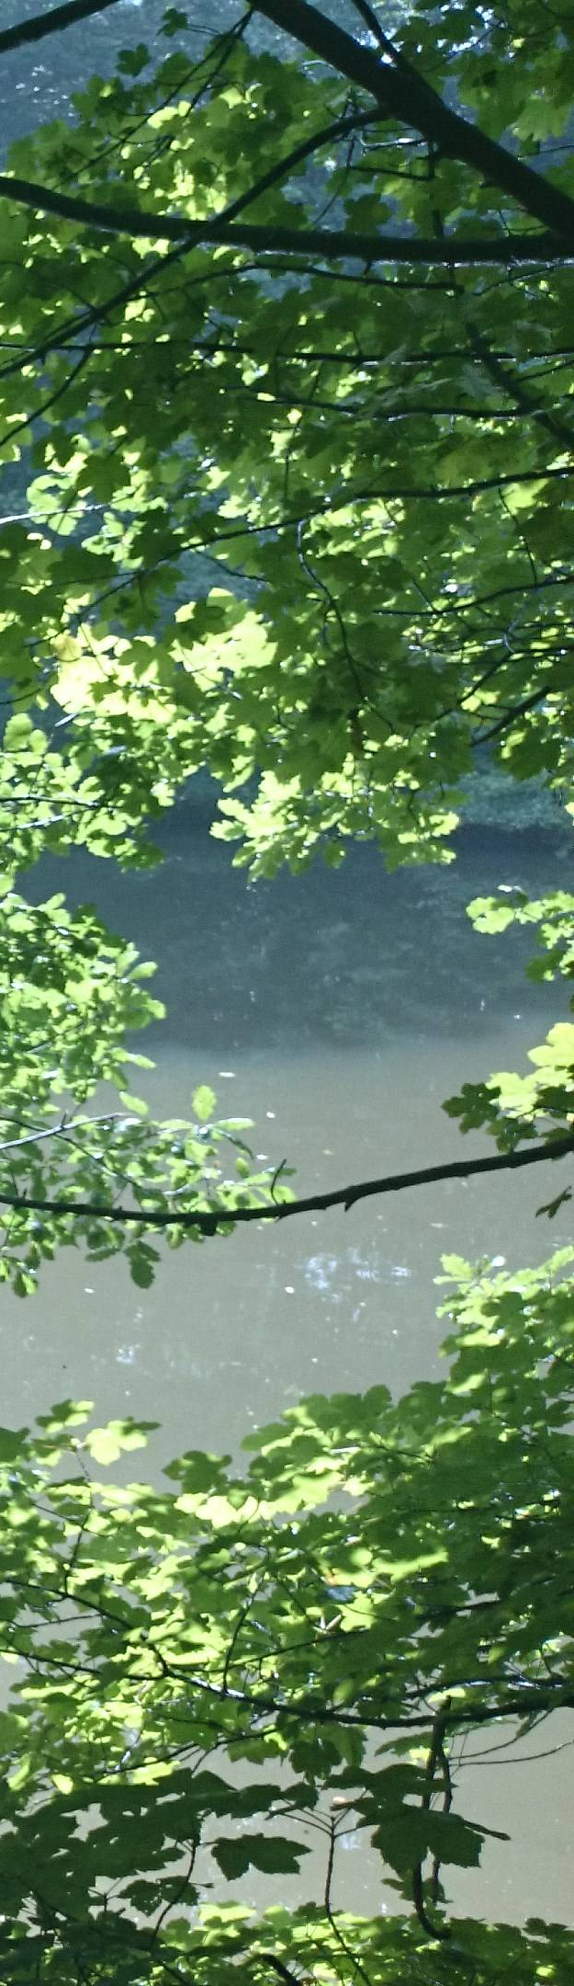
Topic / Purpose Statement
Studies on Attention Restoration Theory (ART) has shown positive effects that Nature can have on attention restoration
But: researchers arbitrarily decided the length of exposure time (usually 15 minutes or more)
Our goal for this project was:
To study the length needed to show measurable effects of Nature exposure through Virtual Reality (VR)
Notes:
Our goal is to restore one’s attention in less than the standard 15 minutes used in previous studies.

Slide 5
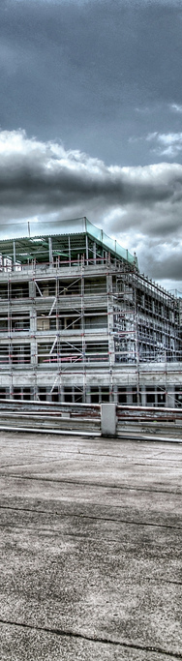
Introduction
Today’s fast pace can have a negative effect on attention
Directed attention is important for productivity and mental stability
Several studies based on ART have validated the positive effects that nature and/or nature scene exposure can have on one’s attention and its restoration
Notes:
Understanding the time needed to restore attention is vital

Slide 6
Related Works / Literature Review / Excerpt
1995 Kaplan
differentiates stress and attention
integrated theory of stress permitting a significant role for attention
both benefit from restorative experiences
2008 M. Berman
effects of nature/urban exposure on attention
2 experiments
Experiments provided validation of ART with nature / viewing nature by photos
2016 Ohly, White, Wheeler, Bethel et al
Systematic review of ART potential
31 studies on ART and its effects
Study highlights diversity in methods and results of restorative experience
2017 A. Anderson
effects of VR nature exposure on stress
2 experiments
Experiments provided different results due to participants perception of stress

Slide 7
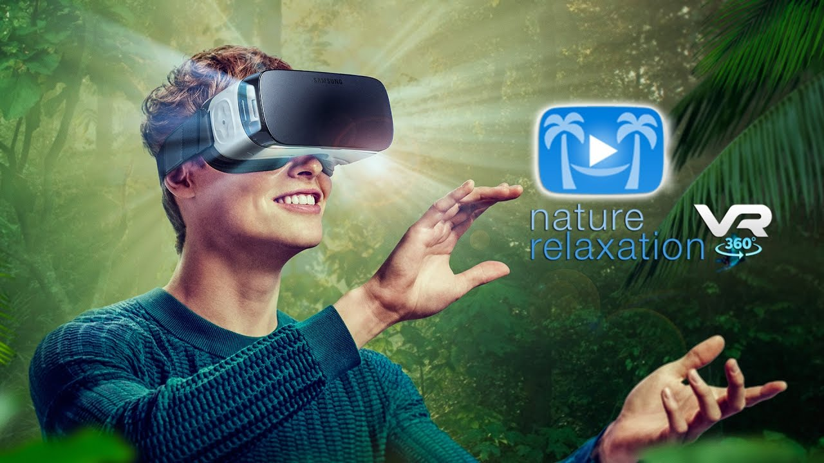
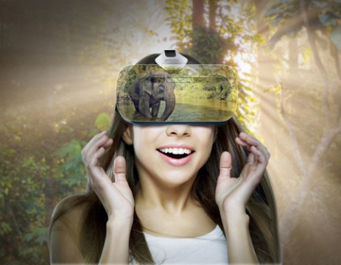
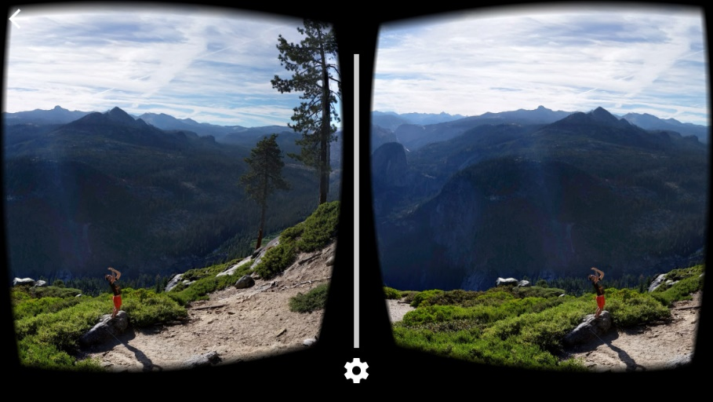
Research Question
Can we measure positives effects for attention restoration on individuals exposed to nature scenes delivered through Virtual Reality?
Notes:
Based on the results from studies conducted on Attention Restoration Theory
These studies, exposed participnats to nature scenes using random lengths of time
Our research question is:

Slide 8

Research Method
For this study our group conducted an experiment
As part of our methodology we used:
Survey:
Dundee Stress Test Questionnaire (DSSQ)
Interactive Test:
2-Back (n-back) cognitive test
Test Of Attentional Vigilance (TOAV)
VR sessions
Using a VR Headset
Quantitative data was gathered for analysis

Slide 9
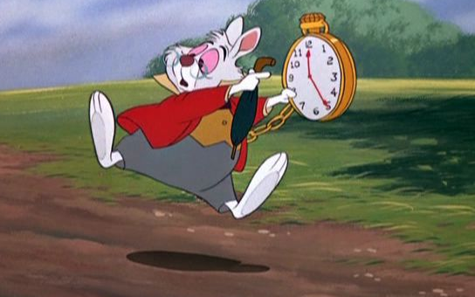
Hypothesis
Exposure to nature scenes through VR can measurably
restore one’s attention in less than 15 minutes

Slide 10
Framework / Setup
Five participants were recruited to conduct three different trials for this experiment
DSSQ (Dundee Stress Test Questionnaire) | 2-Back test | Vigilance tasks | DSSQ (Mood Only) | 2-Back test | VR Session | 2-Back test | DSSQ (Dundee Stress Test Questionnaire)
Emotional baseline | Cognitive baseline | Attention depletion | Emotional state | Cognitive performance | Restoration | Cognitive performance | Emotional state
2 min
8 min
30 min
1 min
8 min
No VR
8 min
2 min
15 min
10 min

Slide 11
Framework / Setup
The participants were provided
DSSQ (Dundee Stress State Questionnaire)
to assess mood, anxiety and subjective stress levels
Then the 2-Back test was administered
to establish the baseline of cognitive performance / “concentration“
The 2-Back test is a continuous performance task to assess and measure working memory and working memory capacity
DSSQ | 2-Back test | Vigilance tasks | DSSQ | 2-Back test | VR Session | 2-Back test | DSSQ

Slide 12
Framework / Setup
Participants took the vigilance tasks (TOAV)
→ To deplete attentive/cognitive resources
DSSQ assessment was conducted again
to assess mood
The 2-Back test was administered again
→ Measurement of attention depletion
DSSQ | 2-Back test | Vigilance tasks | DSSQ | 2-Back test | VR Session | 2-Back test | DSSQ

Slide 13
Framework / Setup
Participants were exposed to nature scenes through a VR headset
Different lengths were used to measure restoration
Trial 1 – no VR exposure, only 15 minute break
Trial 2 – 15 minutes of VR exposure
Trial 3 – 10 minutes of VR exposure
DSSQ | 2-Back test | Vigilance tasks | DSSQ | 2-Back test | VR Session | 2-Back test | DSSQ

Slide 14
Framework / Setup
2-Back test was administered again
Measurement of restoration after VR Nature experience
The participants were provided
DSSQ to assess mood and anxiety
→ Possible confounding variables?
DSSQ | 2-Back test | Vigilance tasks | DSSQ | 2-Back test | VR Session | 2-Back test | DSSQ

Slide 15

Framework / Setup
The experiment was conducted
(ideally) 1 week apart with the same participants using different time intervals
Data Analysis and visualization was conducted using R-software
Hardware used was a PC and the VR glasses Oculus Go
“Guided Relaxation in VR“ application was used to expose the participants to nature scenes
Notes:
Data will be analysed against expected results from Hypothesis.

Slide 16
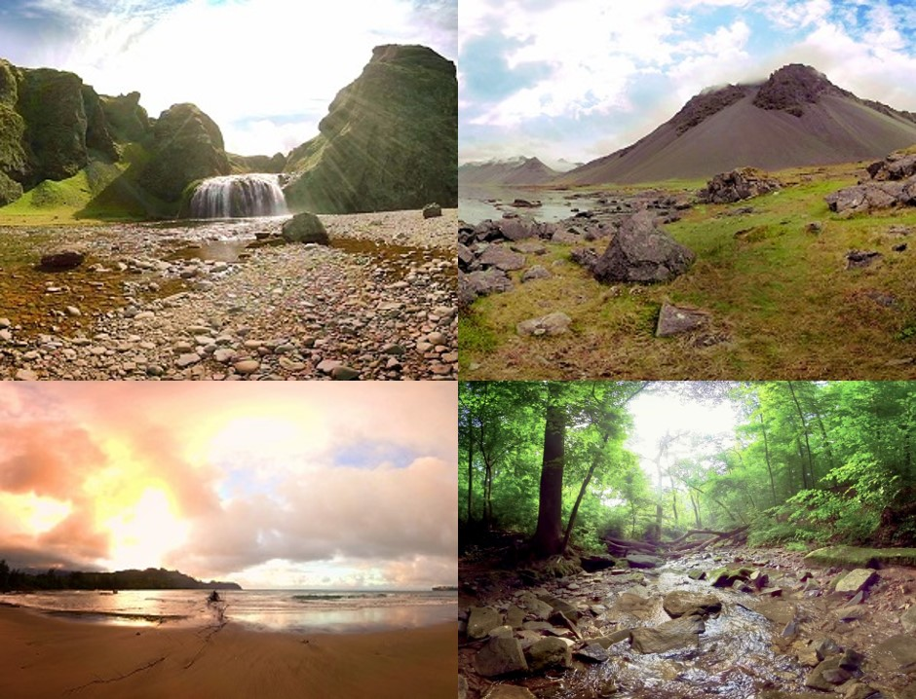
Framework / Setup
The Guided Relaxation in VR application uses realistic nature scene videos
The participant could choose 7 different environments to his/her liking
Notes:
Data will be analysed against expected results from Hypothesis.

Slide 17
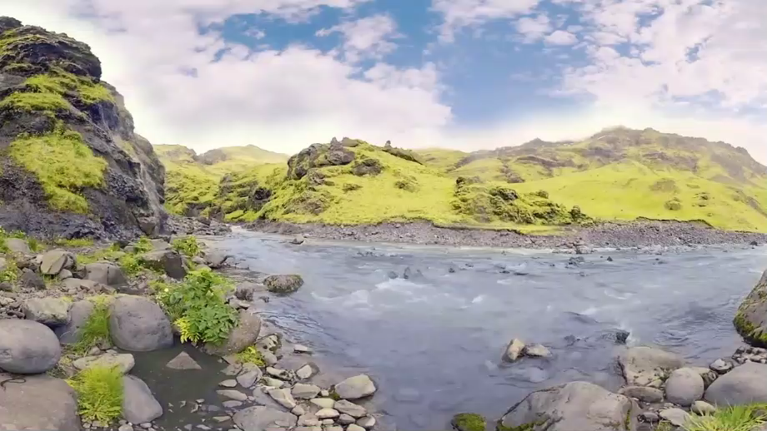
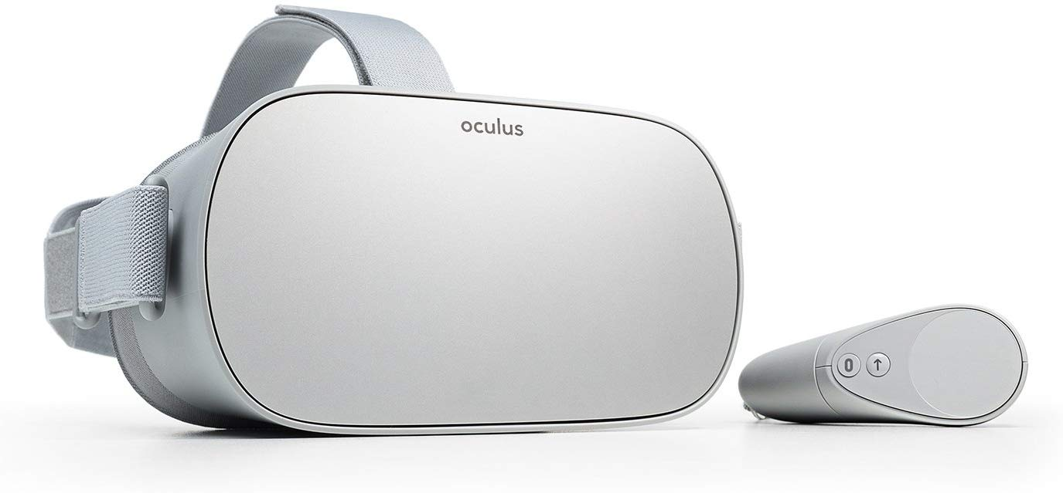
Framework / Setup
The Oculus Go provides a fully immerse, 360° experience
Notes:
Data will be analysed against expected results from Hypothesis.

Slide 18
Results
For this experiment, we collected and analyzed the data as follows:
Relationship between the number of incorrect responses variable in between the 3 n-back tests of each trial
Each 1st test was the baseline used to compare with the results after resource depletion and after restoration
Average response time variable for the 3 n-back tests of each trial

Slide 19
Results
Considering the experiment set-up, this was our “Trend-Expectations“
Incorrect responses
Average Response Time
TOAV
BREAK
TOAV
BREAK
T1
T2
T3
T1
T2
T3

Slide 20
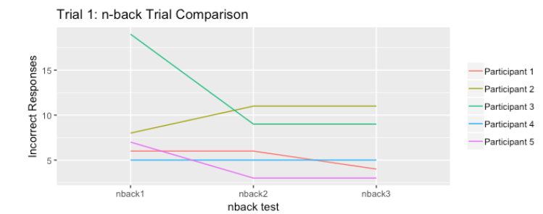
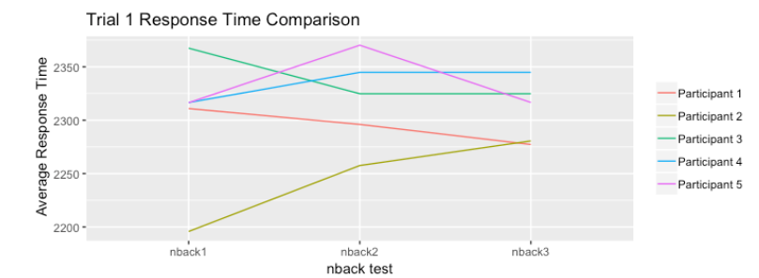
Results
Trial 1 – No VR exposure, 15 minute break only
→ inconclusive, TOAV did not seem to work as expected
→ insufficient data to recognize trends

Slide 21
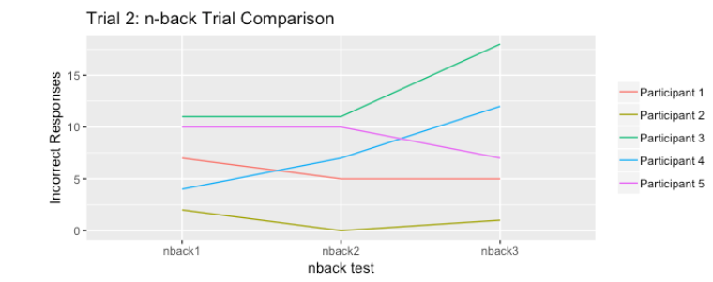
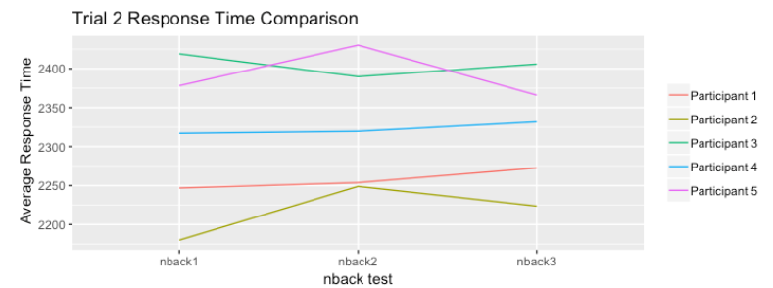
Results
Trial 2 – Using 15 minutes of Relaxation using VR
→ inconclusive, 15 min VR break seems to decrease performance
→ in regard to 10 min VR break, 15 min seem to long (??)

Slide 22
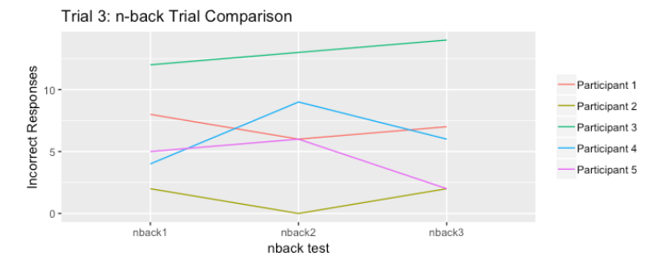
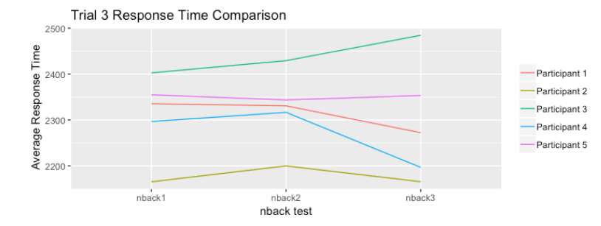
Results
Trial 3 – Using 10 minutes of Relaxation using VR
→ inconclusive, 10 min VR break seems to better for performance
→ still no trends visible, data set too small

Slide 23
Conclusion
The small amount of participants did not provide sufficient data output expected for Attention Restoration Theory
It is unknown if the TOAV produced the desired effects
Not all available data could be analyzed usefully
At this point we reject the Hypothesis:
“Exposure to nature scenes through VR can measurably restore one’s attention in less than 15 minutes”

Slide 24
The Way Ahead
Analyze the effect of the TOAV
→ find alternative task to efficiently deplete attention resources
Enlarge data base
→ using more participants
Evaluate selectiveness of n-back test
→ possibly 3-back test will yield better, more selective results
Use all available data and the respective analysis tools
→ more detailed analysis of response time, TOAV, DSSQ
Additional Research Questions:
→ can a break be too long (boring)
→ whats the maximum regeneration?

Slide 25
What would we do different (what did we learn?)
Make the test shorter, but harder
→ lower burden on participants (time is valuable)
Start earlier with the selection of questionnaires
→ DSSQ was too long, hard to analyze, benefit questionable
Evaluate data analysis tools earlier and more focussed
→ we started to late, things get rushed
Spent more time on experiment design
→ just because others did it doesn’t mean it works for us
→ other prerequisites, experiences, skill levels
Team work needs more planning and management…

Slide 26

Questions ?

